Slide 1

CSE- 322
Software Engineering Lab
Lab : 03 Introduction to Testing
Fahad Ahmed
Lecturer, Dept. of CSE
E-mail: fahadahmed@uap-bd.edu

Slide 2
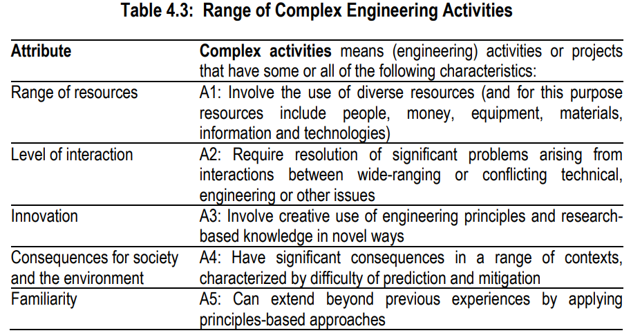
Complex Engineering Activities

Slide 3
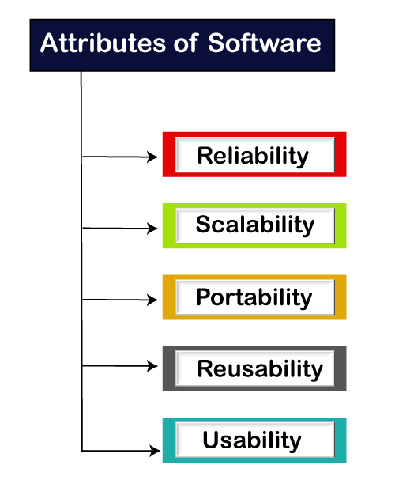

Software testing
Software testing is a process of identifying the correctness of software by considering its all attributes (Reliability, Scalability, Portability, Re-usability, Usability) and evaluating the execution of software components to find the software bugs or errors or defects.

Slide 4
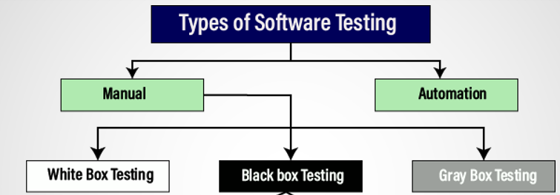
Software Testing

Slide 5
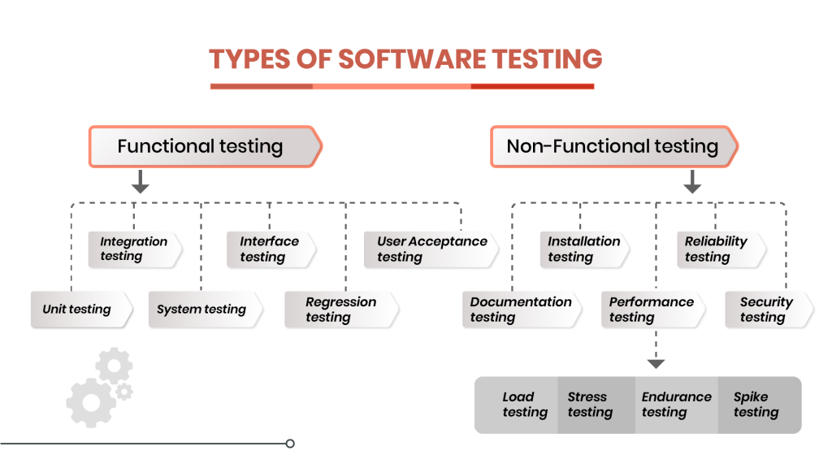
Software Testing

Slide 6
Manual testing
Manual testing
The process of checking the functionality of an application as per the customer needs without taking any help of automation tools is known as manual testing.
While performing the manual testing on any application, we do not need any specific knowledge of any testing tool, rather than have a proper understanding of the product so we can easily prepare the test document.
Manual testing can be further divided into three types of testing, which are as follows:
White box testing
Black box testing
Gray box testing

Slide 7
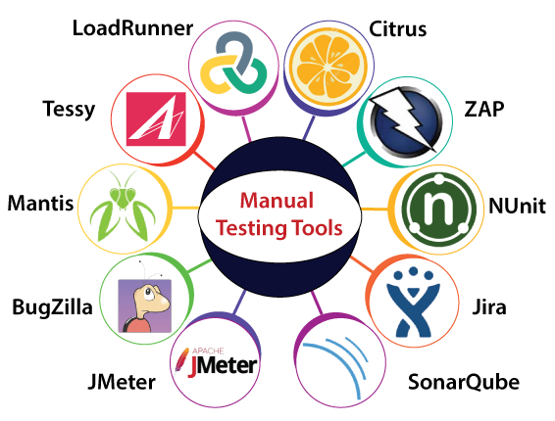
Manual testing tools

Slide 8
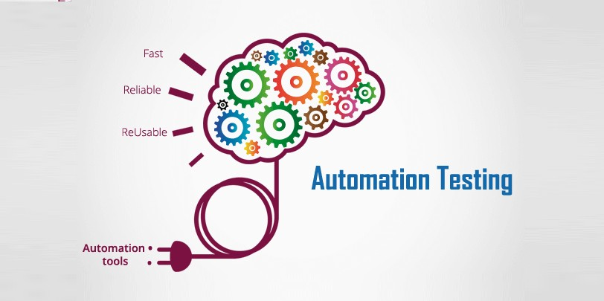
Automation testing
Automation testing is a process of converting any manual test cases into the test scripts with the help of automation tools, or any programming language is known as automation testing.

Slide 9
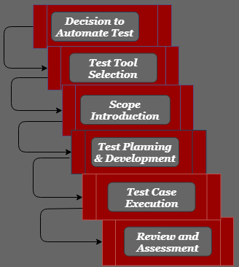
Life cycle of Automation Testing

Slide 10
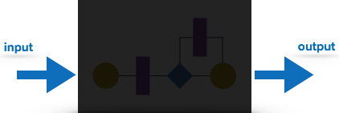
Black box testing
Black box Testing
Black box testing is a technique of software testing which examines the functionality of software without peering into its internal structure or coding.
Black box testing is a method of software testing that examines the functionality of an application
This method of test can be applied to virtually every level of software
The tester is oblivious to the system architecture and does not have access to the source code

Slide 11
Black box testing
Black-box testing techniques:
Decision Table Technique | Decision Table Technique is a systematic approach where various input combinations and their respective system behavior are captured in a tabular form. It is appropriate for the functions that have a logical relationship between two and more than two inputs.
Boundary Value Technique | Boundary Value Technique is used to test boundary values, boundary values are those that contain the upper and lower limit of a variable. It tests, while entering boundary value whether the software is producing correct output or not.
State Transition Technique | State Transition Technique is used to capture the behaviour of the software application when different input values are given to the same function. This applies to those types of applications that provide the specific number of attempts to access the application.
All-pair Testing Technique | All-pair testing Technique is used to test all the possible discrete combinations of values. This combinational method is used for testing the application that uses checkbox input, radio button input, list box, text box, etc.

Slide 12
Black box testing
Black-box testing techniques:
Cause-Effect Technique | Cause-Effect Technique underlines the relationship between a given result and all the factors affecting the result. It is based on a collection of requirements.
Equivalence Partitioning Technique | Equivalence partitioning is a technique of software testing in which input data divided into partitions of valid and invalid values, and it is mandatory that all partitions must exhibit the same behavior.
Error Guessing Technique | Error guessing is a technique in which there is no specific method for identifying the error. It is based on the experience of the test analyst, where the tester uses the experience to guess the problematic areas of the software.
Use Case Technique | Use case Technique used to identify the test cases from the beginning to the end of the system as per the usage of the system. By using this technique, the test team creates a test scenario that can exercise the entire software based on the functionality of each function from start to end.

Slide 13
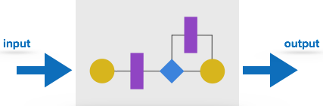
White Box Testing
White box testing is a method of testing software that tests internal structures or working of an application
In white-box testing an internal perspective of the system , as well as programming skills, are used to design test cases
It is also known as clear box testing, glass box testing, transparent box testing, and structural testing
White box testing is the detailed investigation of internal logic and structure of the code
In order to perform white box testing of an application , the tester needs to possess knowledge of the internal working of the code

Slide 14
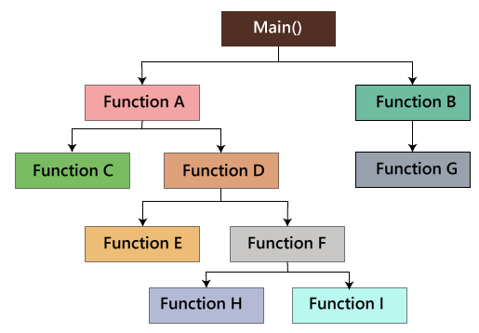
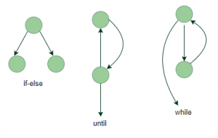
White Box Testing
White Box Testing techniques:
The white box testing contains various parts, which are as follows:
Statement coverage
Testing based on the memory (size) perspective
Condition testing : Multiple Condition Coverage
Basis Path test
Flow graph notation
Loop Testing
https://www.geeksforgeeks.org/software-engineering-white-box-testing/?ref=lbp

Slide 15
GreyBox Testing
Grey-box testing is a software testing method to test the software application with partial knowledge of the internal working structure.
It is a combination of black box and white box testing because it involves access to internal coding to design test cases as white box testing and testing practices are done at functionality level as black box testing.

Slide 16
GreyBox Testing
Gray Box Testing Techniques:
Matrix Testing
Pattern Testing
Orthogonal Array Testing
Regression Testing
https://www.geeksforgeeks.org/gray-box-testing-software-testing/?ref=rp

Slide 17
TEST CASE
What is a Test Case?
A TEST CASE is a set of actions executed to verify a particular feature or functionality of your software application.
A Test Case contains test steps, test data, precondition, post-condition developed for specific test scenario to verify any requirement.
The test case includes specific variables or conditions, using which a testing engineer can compare expected and actual results to determine whether a software product is functioning as per the requirements of the customer.

Slide 18
TEST CASE
Typical Test Case Parameters:
Test Case ID, name, date, portfolio
Test Scenario
Test Case Description
Test Steps
Prerequisite
Test Data
Expected Result
Test Parameters
Actual Result
Environment Information
Comments

Slide 19
Decision table approach
Derive test cases based on decision-table approach, execute the test cases and discuss the results : if-else block
For Example:
Design and develop a program in a language (C) of your choice to solve the triangle problem defined as follows : Accept three integers which are supposed to be the three sides of triangle and determine if the three values represent an equilateral triangle, isosceles triangle, scalene triangle, or they do not form a triangle at all.

Slide 20
Decision table approach
#include<stdio.h>
int main()
{
int a,b,c;
char istriangle;
printf("enter 3 integers which are sides of triangle\n");
scanf("%d%d%d",&a,&b,&c);
printf("a=%d, b=%d, c=%d\n",a,b,c);
if( a<b+c && b<a+c && c<a+b )
istriangle='y';
else
istriangle ='n';
if (istriangle=='y')
if ((a==b) && (b==c))
printf("equilateral triangle\n");
else if ((a!=b) && (a!=c) && (b!=c))
printf("scalene triangle\n");
else
printf("isosceles triangle\n");
else
printf("Not a triangle\n");
return 0;
}

Slide 21
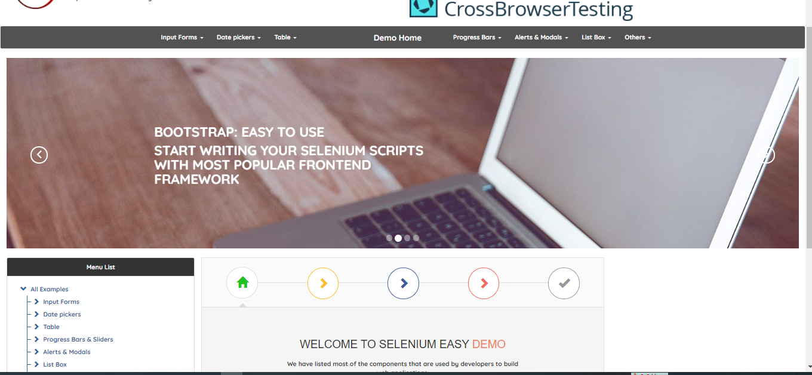
Selenium
https://www.seleniumeasy.com/test/

Slide 22
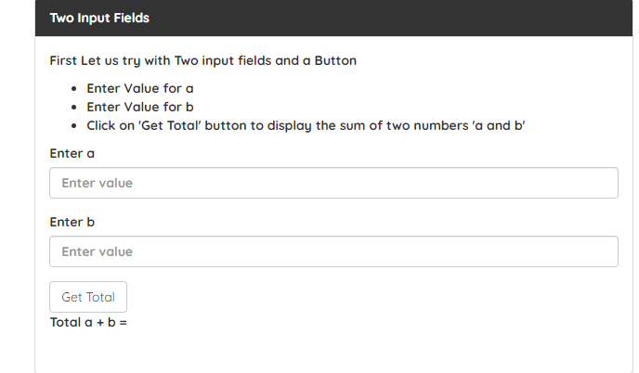
Selenium
https://www.seleniumeasy.com/test/

Slide 23
Selenium
Selenium is a powerful tool for controlling web browsers through programs and performing browser automation.
It is functional for all browsers, works on all major OS and its scripts are written in various languages i.e Python, Java, C#, etc, we will be working with Python.
We want to cover by using selenium
Navigating web URL
Click
Type(Text)
Read and Response
Some basic functions … …

Slide 24
Selenium
Limitations of Selenium
No support for desktop applications – Selenium does not support testing for desktop applications.
Open Source Forums – Since Selenium is open source software, one has to rely on community forums to get your technical issues resolved.
No support for REST and SOAP Platforms – We can’t perform automation tests on web services like SOAP or REST using Selenium.
No Reporting capability – Selenium does not have any inbuilt reporting capability, one has to rely on plug-ins like JUnit and TestNG for test reports.
Image Testing – It is not possible to perform testing on images. One needs to integrate Selenium with Sikuli for image testing.

Slide 25
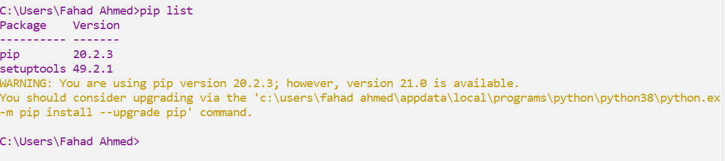
Check Selenium

Slide 26
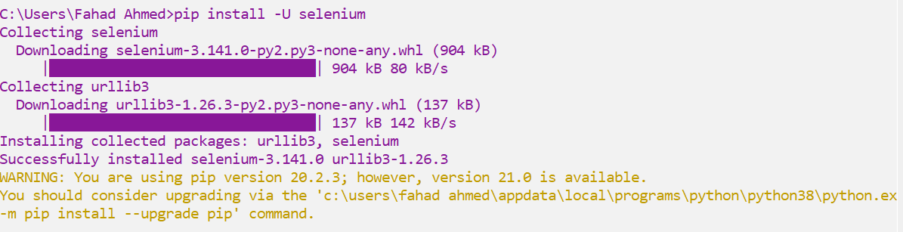
Install Selenium
Use pip to install the selenium package. Python 3.6 has pip available in the standard library. Using pip, you can install selenium like this:
pip install –U selenium

Slide 27
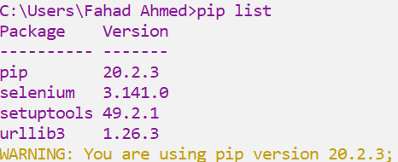
Check Selenium

Slide 28

PyCharm
JetBrains PyCharm 2020.1 build 201.6668.115

Slide 29

Thanks to All

